Slide 1

Measures of Spread – What and When?

Slide 2
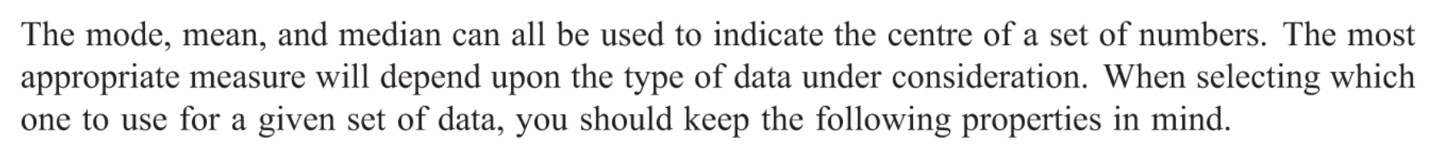
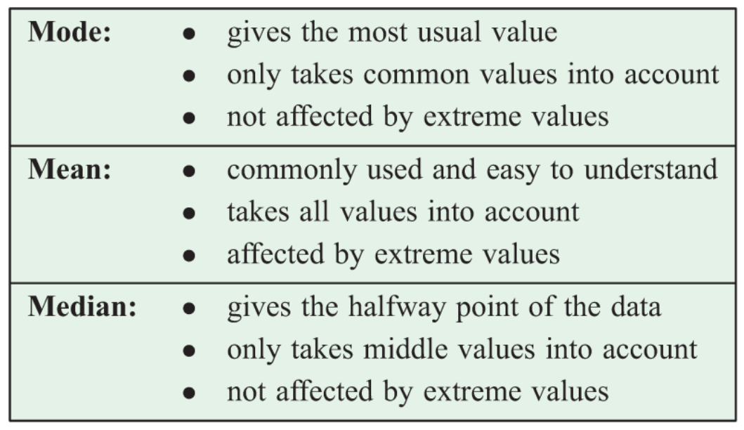
24
7
30
Measuring the Centre of Data
Date
EQ – How do we measure the centre of the data?
Choosing the correct measure of data

Slide 3
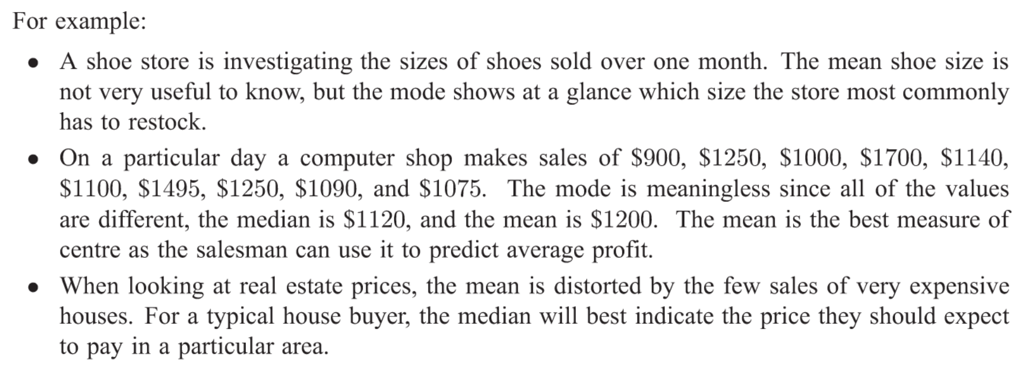

Slide 4
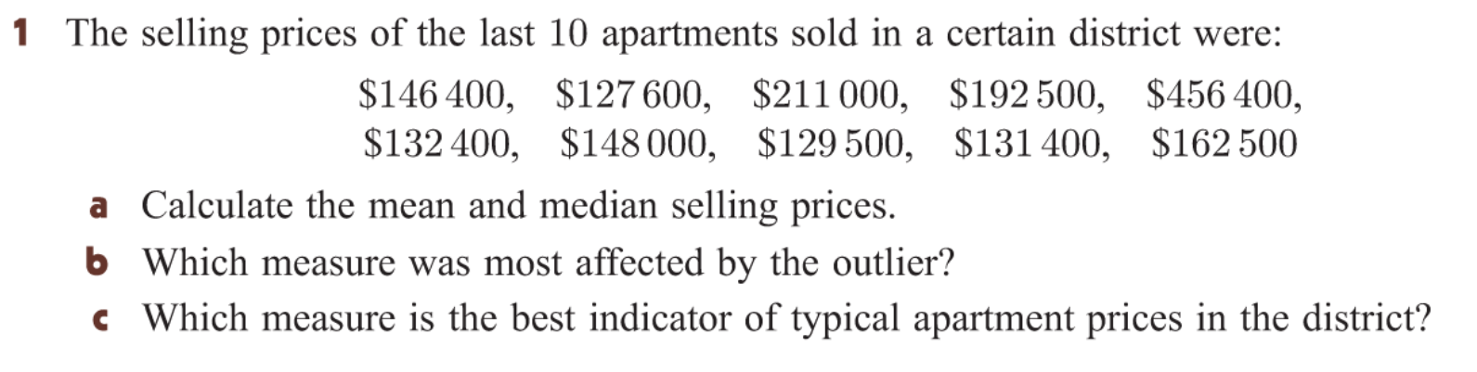
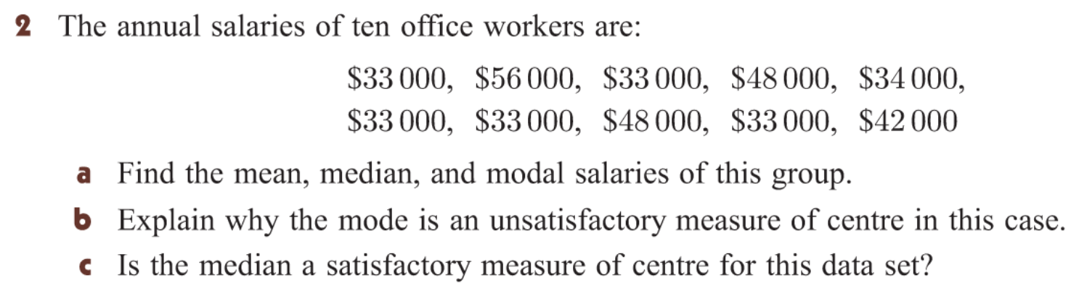

Slide 5
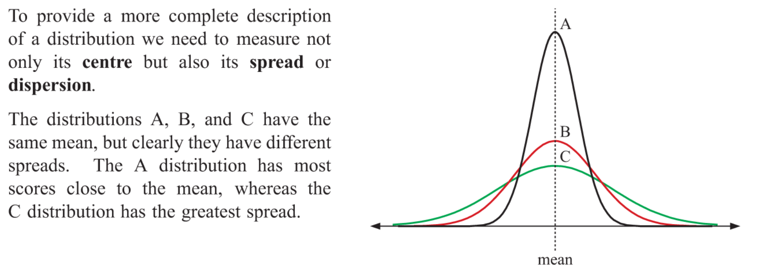
24
7
30
Measuring the Spread of Data
Date
EQ – How do I work out the range of the data?

Slide 6
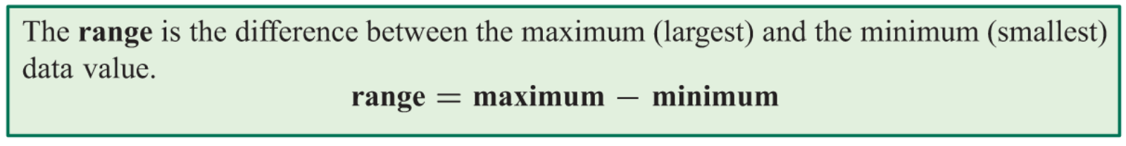
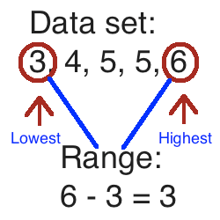
24
7
30
Measuring the Spread of Data
Date
EQ – How do I work out the range of the data?
What is the Range?

Slide 7
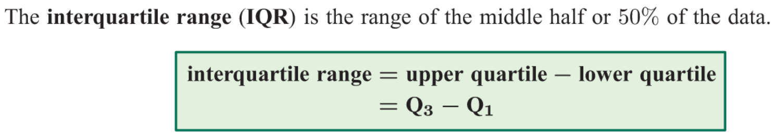
24
7
30
Measuring the Spread of Data
Date
EQ – How do I work out the range of the data?
The median divides the data into two half’s. These half’s are divided in half again by the quartiles.
The middle value of the lower half of the data is called the lower quartile or 25th percentile.
The middle value of the top half of the data is called the upper quartile or 75th percentile.
What are Quartiles and the Interquartile Range?

Slide 8
